Slide 1
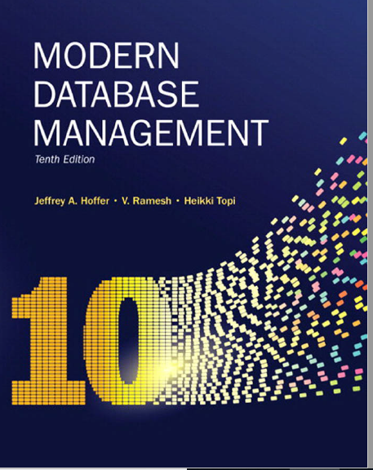
Chapter 7: Advanced SQL
Multiple Table Processing
-JOIN-

Slide 2
Objectives
Define terms
Write single and multiple table SQL queries
Define and use types of joins
Write noncorrelated and correlated subqueries
Establish referential integrity in SQL
Notes:
So far, we learned how to retrieve data from one table, we will learn of to retrieve data from multiple tables
We will cover three types of joins

Slide 3
Processing Multiple Tables–Joins
Join–a relational operation that causes two or more tables with a common domain to be combined into a single table or view
Equi-join–a join in which the joining condition is based on equality between values in the common columns; common columns appear redundantly in the result table
Natural join–an equi-join in which one of the duplicate columns is eliminated in the result table
The common columns in joined tables are usually the primary key of the dominant table and the foreign key of the dependent table in 1:M relationships
Notes:
JOIN : an operation to link entities and relationships together for data retrieval
EQUI-JOIN : join based on equality
NATURAL JOIN: equi-join in which one of the duplicate column is eliminated in the result table

Slide 4
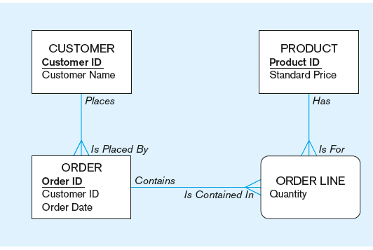
The following slides use tables for this enterprise data model
(from Chapter 1, Figure 1-3)

Slide 5
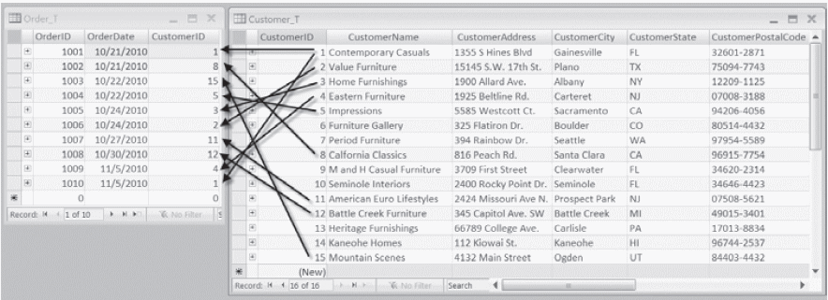
Figure 7-1 Pine Valley Furniture Company Customer_T and Order_T tables with pointers from customers to their orders
These tables are used in queries that follow
Notes:
Example of 1:M relationship.
Customer ID 1 has 2 orders
CustID 2 has only 1 order
Cust ID 3 only 1 order, 7 no order
Overall, some customers have not order, some customers have only one order, etc.

Slide 6
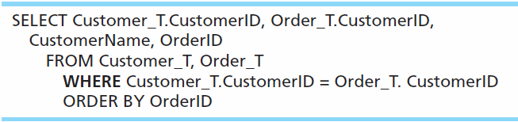
Equi-Join Example
For each customer who placed an order, what is the customer’s name and order number?
Customer ID appears twice in the result
Notes:
How do you return a result set of all customer with
Equi-join is based on equality

Slide 7
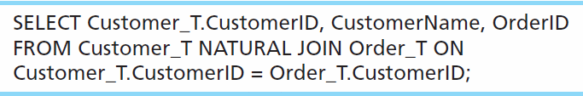
Natural Join Example
For each customer who placed an order, what is the customer’s name and order number?
Join involves multiple tables in FROM clause
ON clause performs the equality check for common columns of the two tables
Notes:
Postgress, MySQL, and Oracle support Natural joins. SQL Server and DB2 do NOT

Slide 8
Book’s version: Three Types of JOIN
Natural JOIN – not supported by many vendors, can be achieved via INNER JOIN
Equi JOIN - not need to differentiate joins based on equality. Other operators such as >=, <=, <> between etc.
UNION JOIN - commonly referred to as FULL JOIN

Slide 9
Practical Version: Types of JOINS
Inner Join
Outer Join
Left Outer Join
Right Outer Join
Full Join

Slide 10
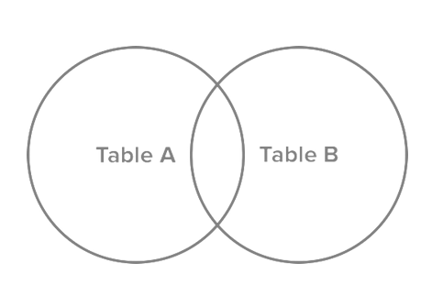
JOINS visualization

Slide 11
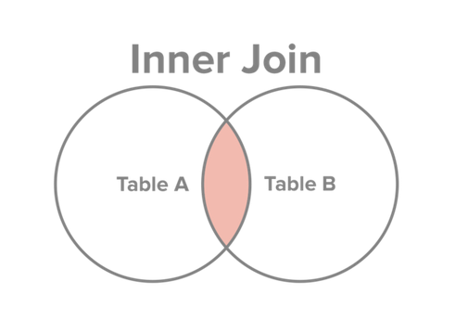
INNER JOIN
Join condition must match on both sides. PK and FK must exist in both tables
Records from Table A and Table B, where the join condition is met.
http://www.sql-join.com/sql-join-types/

Slide 12
INNER JOIN SQL
For each customer who placed an order, what is the customer’s name and order number?
SELECT c. CustomerID, c.CustomerName, o.OrderID
FROM Customer c INNER JOIN ORDER AS o ON c.CustomerID = o.CustomerID
ON clause performs the equality check for common columns of the two tables
Join involves multiple tables in FROM clause
Keyword INNER is optional:
SELECT c. CustomerID, c.CustomerName, o.OrderID
FROM Customer c JOIN ORDER AS o ON c.CustomerID = o.CustomerID
Notes:
This query returns only customers that have orders,
If a customer doesn’t have orders it doesn’t show up

Slide 13
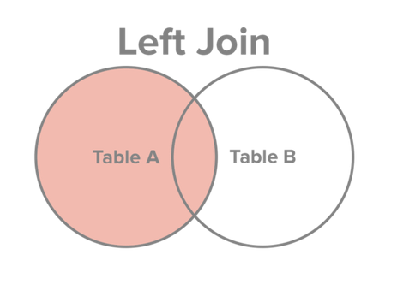
LEFT OUTER JOIN
All data from A even it doesn’t match B. In cases where there is a match, show the data from B, otherwise show NULL
Select all records from Table A, along with records from Table B for which the join condition is met (if at all).
http://www.sql-join.com/sql-join-types/

Slide 14
LEFT OUTER JOIN SQL
SELECT c. CustomerID, c.CustomerName, o.OrderID
FROM Customer c LEFT OUTER JOIN ORDER AS o ON c.CustomerID = o.CustomerID
Keyword OUTER is optional:
SELECT c. CustomerID, c.CustomerName, o.OrderID
FROM Customer c LEFT JOIN ORDER AS o ON c.CustomerID = o.CustomerID
Notes:
This query returns only customers that have orders,
If a customer doesn’t have orders it doesn’t show up

Slide 15
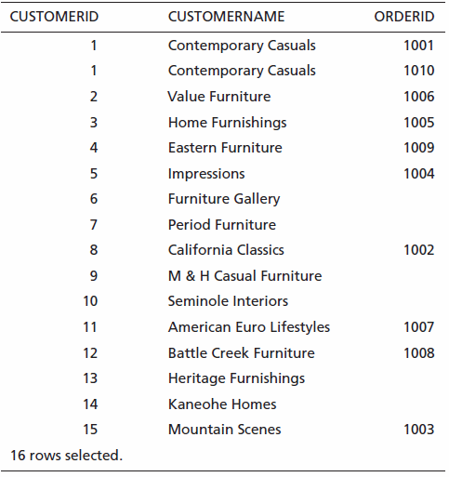
Results
Outer JOIN,
NULL values
Unlike INNER join, this will include customer rows with no matching order rows
Notes:
What happens when records content match the other table , displays NULL, empty

Slide 16
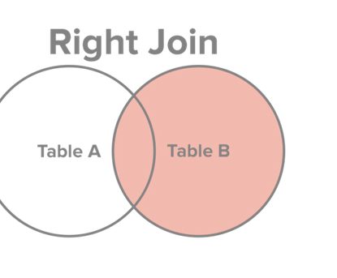
RIGHT OUTER JOIN
Select all records from Table B, along with records from Table A for which the join condition is met (if at all).
Same as LEFT except table on the right side of the JOIN is the base table

Slide 17
RIGHT OUTER JOIN SQL
SELECT c. CustomerID, c.CustomerName, o.OrderID
FROM Order o RIGHT OUTER JOIN Customer c ON c.CustomerID = o.CustomerID
Key word OUTER is optional:
SELECT c. CustomerID, c.CustomerName, o.OrderID
FROM Order o RIGHT JOIN Customer c ON c.CustomerID = o.CustomerID
Notes:
This query returns only customers that have orders,
If a customer doesn’t have orders it doesn’t show up

Slide 18
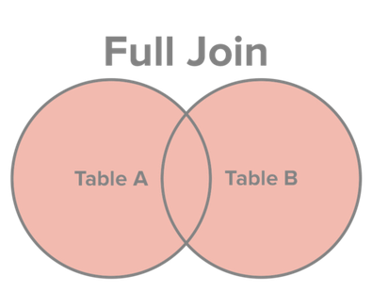
FULL JOIN
Select all records from Table A and Table B, regardless of whether the join condition is met or not.
Same as LEFT JOIN and RIGHT JOIN simultaneously

Slide 19
FULL JOIN SQL
SELECT c. CustomerID, c.CustomerName, o.OrderID
FROM Customer c FULL JOIN ORDER o AS o ON c.CustomerID = o.CustomerID
Notes:
This query returns only ORDERS orders,
If a customer doesn’t have orders it doesn’t show up

Slide 20
Different JOIN syntax
SELECT c.CustomerID, CustomomerName, OrderID
FROM Customer c INNER JOIN Order o ON c.CustomerID = o.CustomerID
SELECT Custsomer.CustomerID, CustomomerName, OrderID
FROM Customer, Order
WHERE Customer.CustomerID = OrderCustomerID
ANSI 92 syntax
Notes:
Implicit and explicit JOIN notations
Implicit JOIN notation -> no longer considered best practice!
Which syntax is better, the one on top, the other is prior SQL 92 standards.

Slide 21
Multiple Table Join Example
SELECT c.CustomerID, c.CustomerName, c.CustomerAddress, c.CustomerCity, c.CustomerState, c.CustomerPostalCode, o.OrderID, o.OrderDate, ol.OrderedQuantity, p.ProductDescription, p.StandardPrice, ( ol.OrderedQuantity*p.ProductStandardPrice)
FROM Customer c JOIN Order o ON c.CustomerID = o.CustomerID
JOIN OrderLine ol ON o.OrderID = ol.OrderID
JOIN Product p ON ol.ProductID = p.ProductID
WHERE o.OrderID = 1006

Slide 22
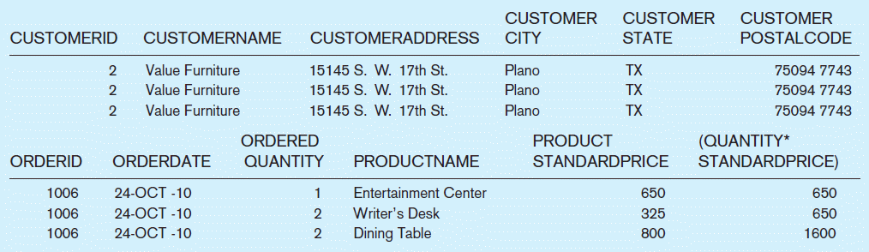
Figure 7-4 Results from a four-table join (edited for readability)
From CUSTOMER table
From ORDER table
From PRODUCT table

Slide 23
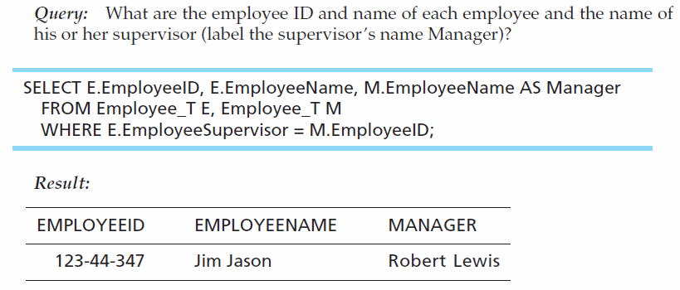
Self-Join Example
SELECT e.EmployeeID, e.EmployeeName, m.EmployeeName As Manager
FROM Employee e JOIN Employee m ON e.ManagerID = m.EmployeeID
The same table is used on both sides of the join; distinguished using table aliases
Self-joins are usually used on tables with unary relationships
Notes:
Use of alias

Slide 24
JOIN Exercise 1
Write a SQL query to return employee names ( first and last) and the location of their work ( from department).
Notes:
SELECT e.emp_fname, e.emp_lname, d.location
FROM department d JOIN employee e on e.dept_no = d.dept_no
( show old SQL JOIN)
-- ADD ANOTHER EMPLOYEE AND SHOW THEM HOW RESULTS IS DIFFERENT

Slide 25
JOIN Exercise 2
Write a SQL query to return employee names (first and last) and their job function for the project they work(ed) on. Display blank for employees with no projects.
Notes:
SELECT e.emp_fname, e.emp_lname, w.job
FROM employee e left join works_on w on e.emp_no = w.emp_no

